Slide 1


Robot
Vision
Vadim Tikhanoff
Valentina Vasco

Slide 2
Robot Vision - Contents
01
Introduction to
computer vision
02
03
2D Robot Vision
3D Robot Vision
Computer Vision Scope
Challenges in Computer Vision
Understanding Images
Examples of 2D Vision in robots
Introduction to image processing
Tutorial on image processing
Examples of 3D Vision in robots
Introduction to PCL
Assignment on Model Alignment

Slide 3
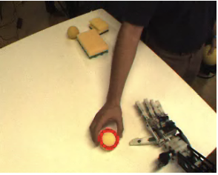
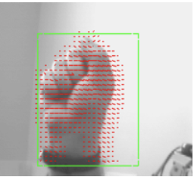
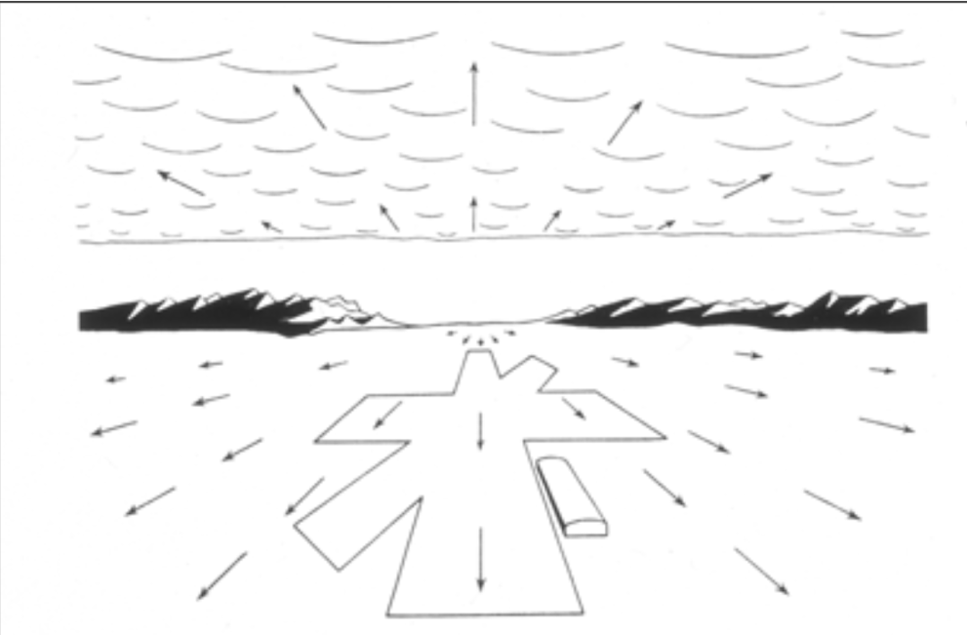
01 – Introduction to Computer Vision
Why should we study Vision
It is a powerfull perceptual modality (the most powerfull?), allowing
the acquisition of very rich information of the surrounding environment
Object position and velocities
Relationships among objects
Object identity
Interact with the world in a non-invasive way (without physical contact)
Complex perceptual system. Above 50% of the human visual cortex is dedicated to processing visual information
Biological systems are still not very well understood

Slide 4
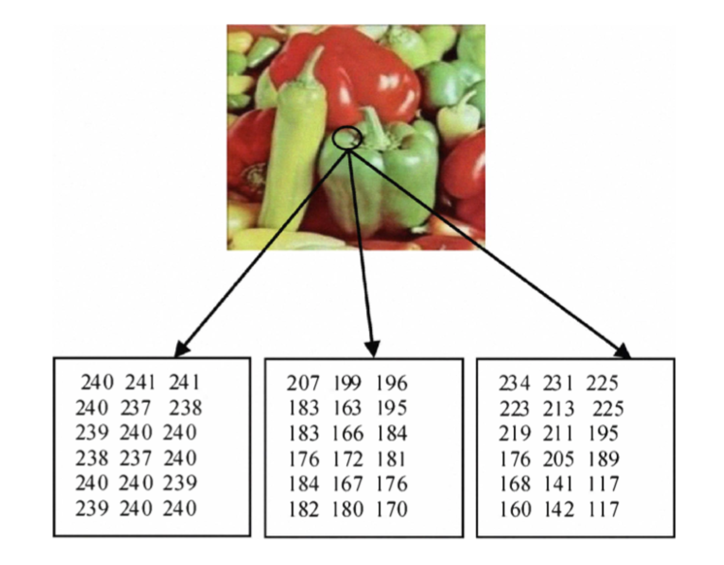
01 – Introduction to Computer Vision
What is an Image?

Slide 5
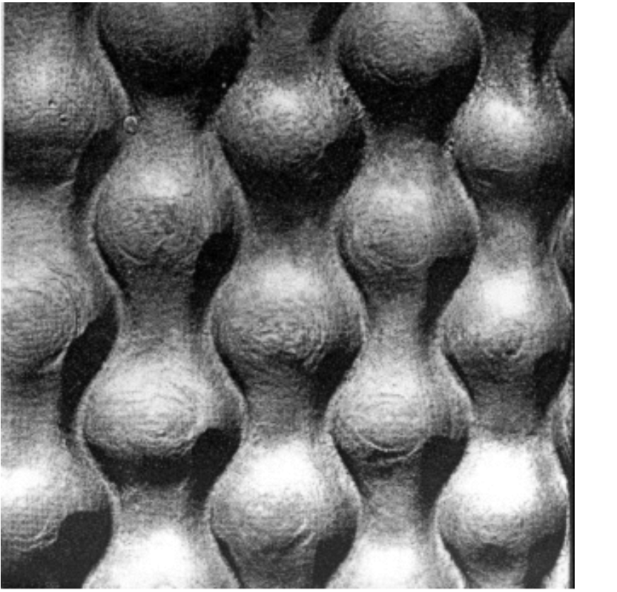
01 – Introduction to Computer Vision
What is an Image?

Slide 6
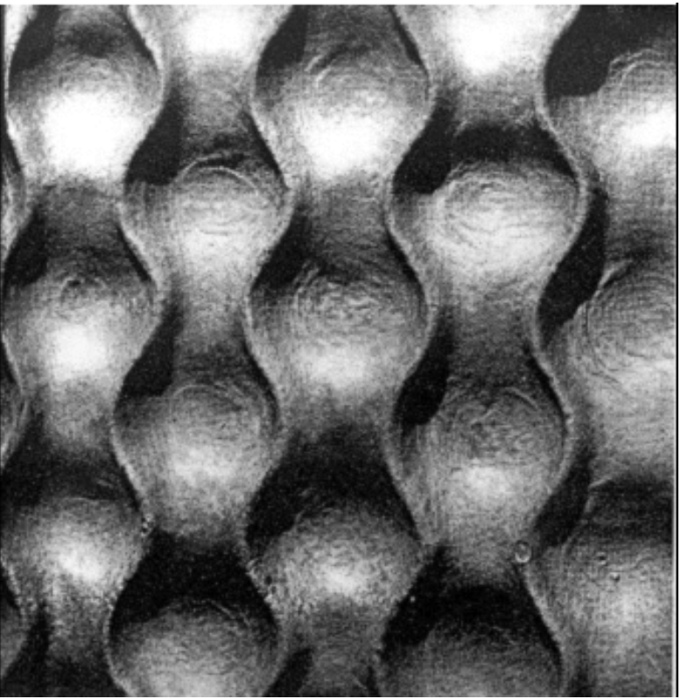
01 – Introduction to Computer Vision
What is an Image?

Slide 7
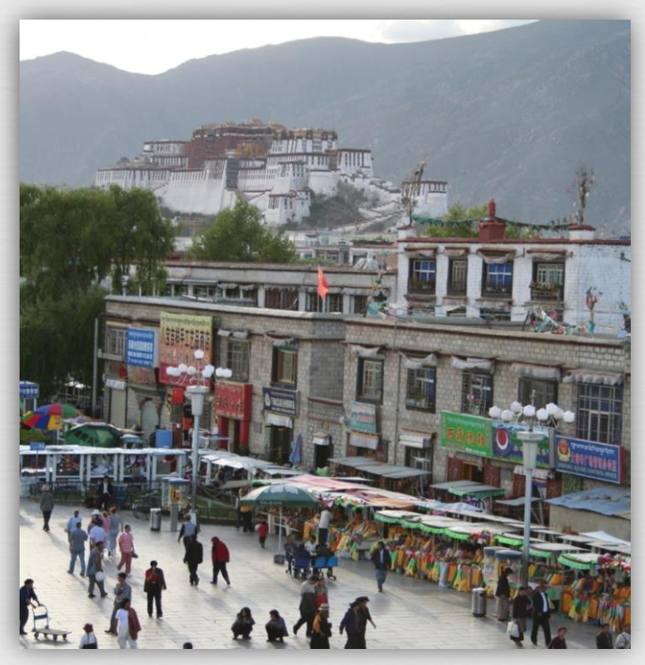
01 – Introduction to Computer Vision
Make computer/robots understand images and videos
Specific Recognition Tasks
Outdoor, indoor
City, forest, factory
Image Annotation
Street
People
Buildings
Mountains
Tourism
Cloudy
Bricks

Slide 8
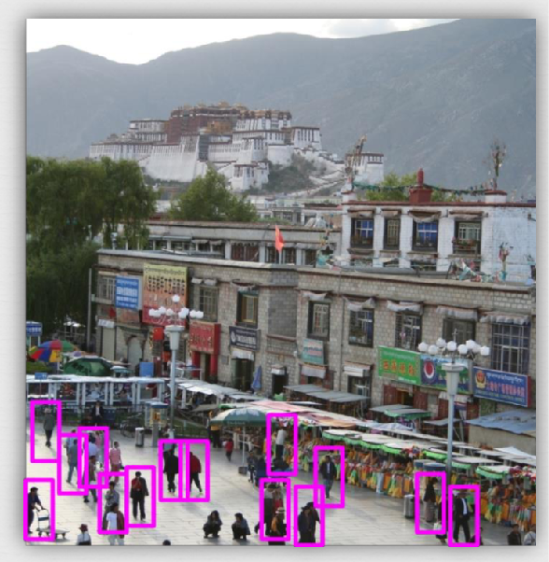
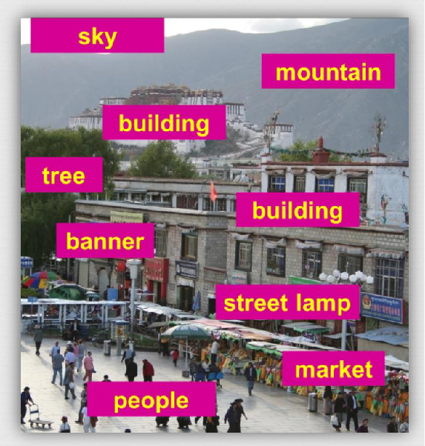
01 – Introduction to Computer Vision
Make computer/robots understand images and videos
Object Detection
Find Pedestrian
Image Segmentation

Slide 9
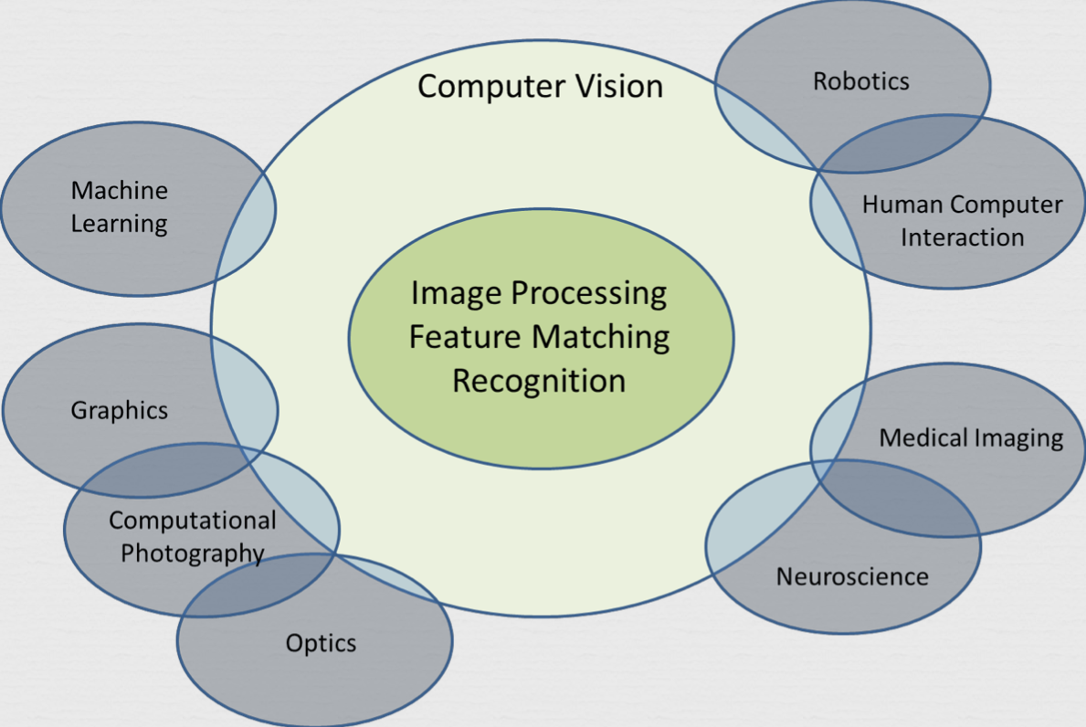
01 – Introduction to Computer Vision
Computer Vision Scope

Slide 10
01 – Introduction to Computer Vision
Computer Vision is Challenging…

Slide 11
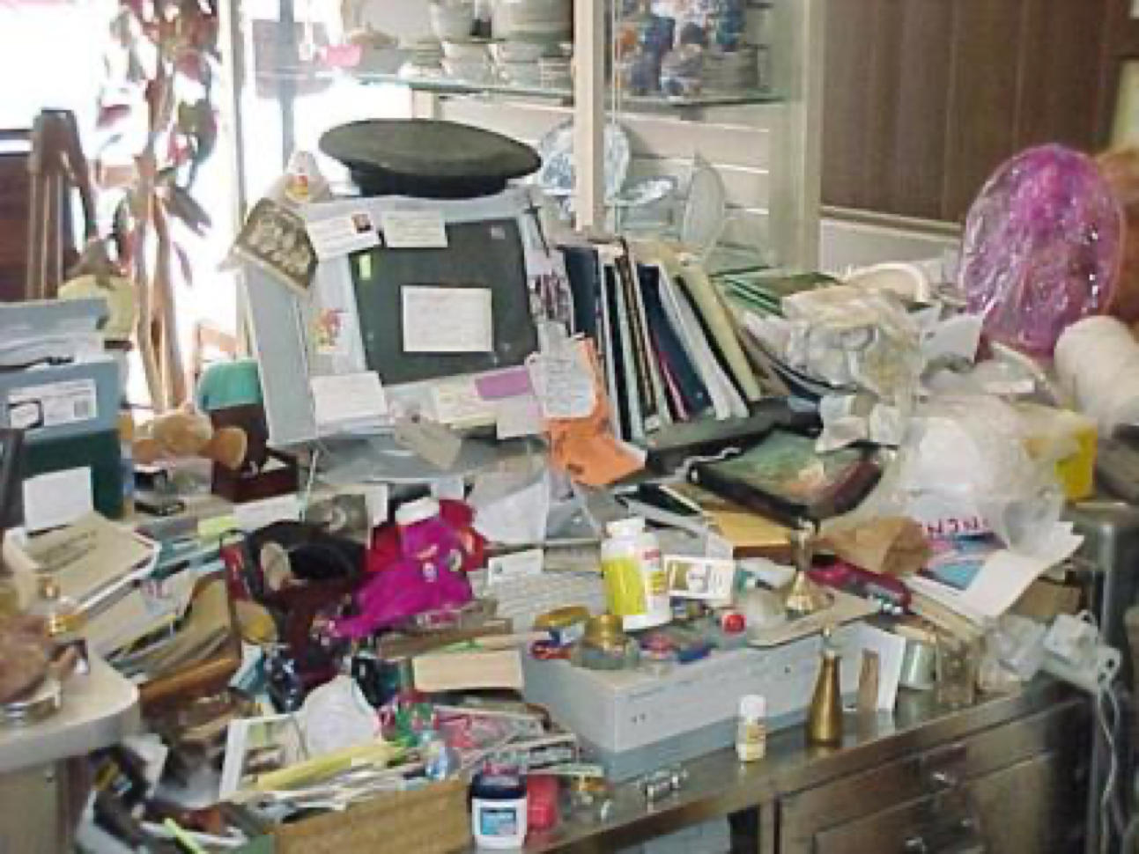
01 – Introduction to Computer Vision
Computer Vision is Challenging…
First task:
Find remote control

Slide 12
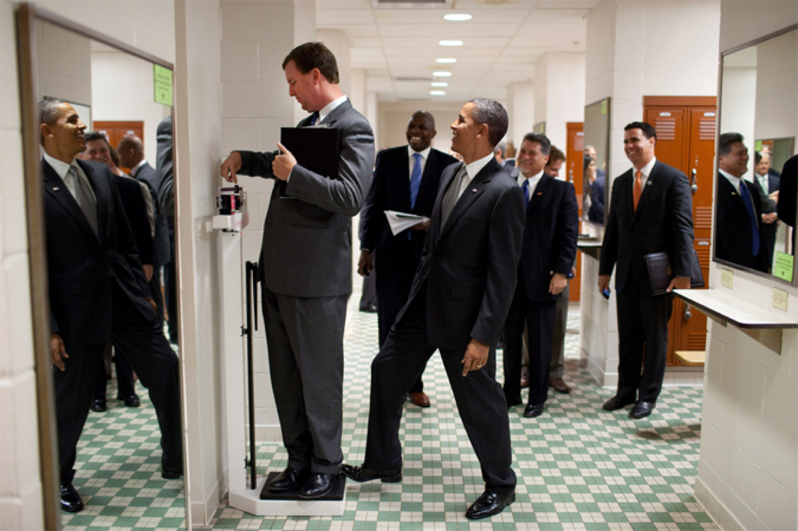
01 – Introduction to Computer Vision
Computer Vision is Challenging…
More realistic tasks:
Where was this picture taken?
How many people are there?
What are they doing?
What is the object the person on the left is standing on?
Why is this a funny picture?

Slide 13
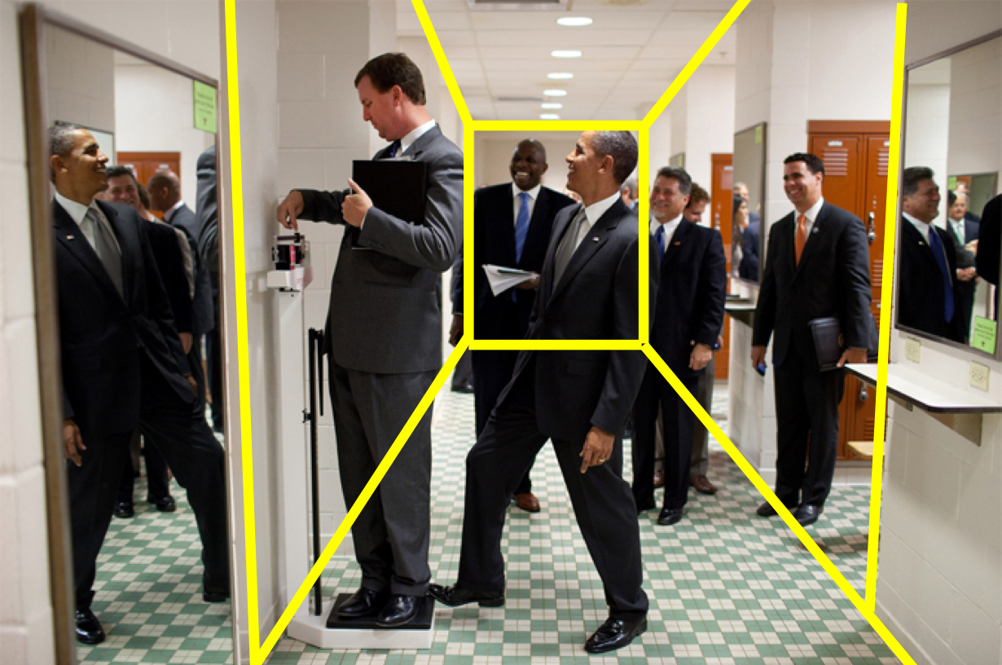
01 – Introduction to Computer Vision
Computer Vision is Challenging…
More realistic tasks:
Where was this picture taken?
How many people are there?
What are they doing?
What is the object the person on the left is standing on?
Why is this a funny picture?

Slide 14
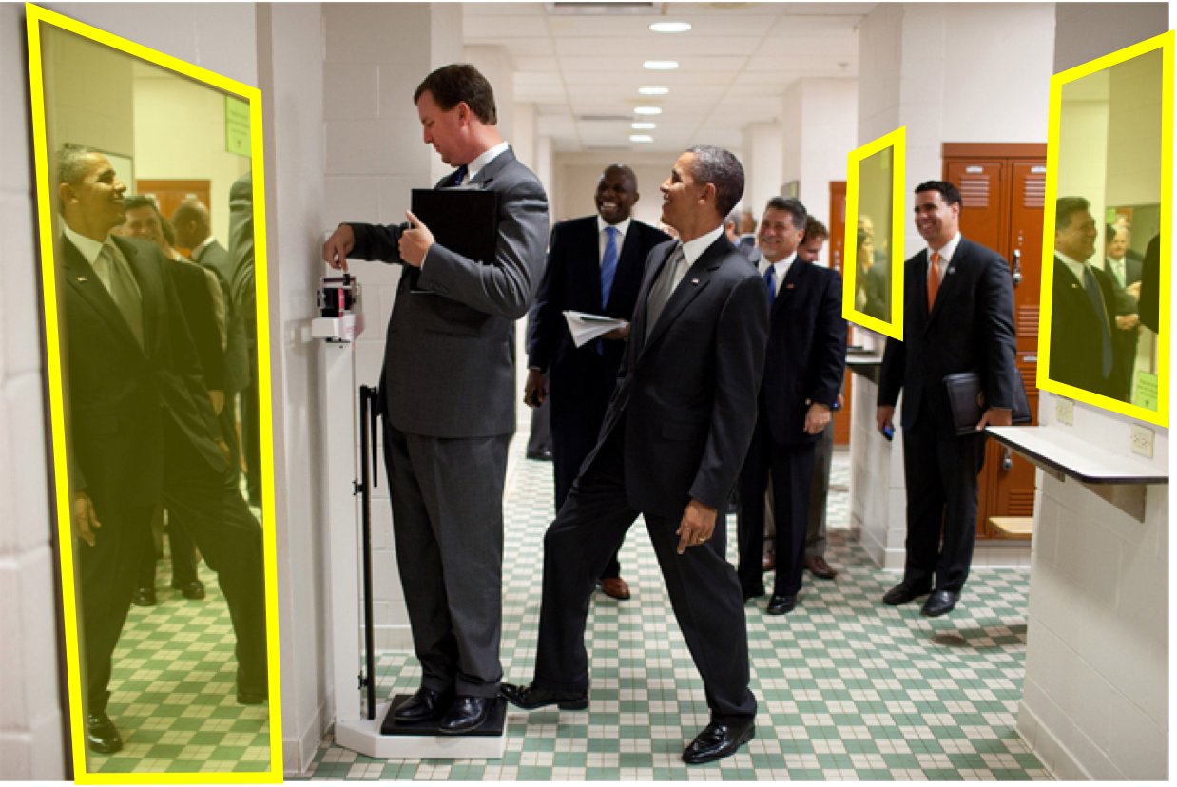
01 – Introduction to Computer Vision
Computer Vision is Challenging…
More realistic tasks:
Where was this picture taken?
How many people are there?
What are they doing?
What is the object the person on the left is standing on?
Why is this a funny picture?

Slide 15
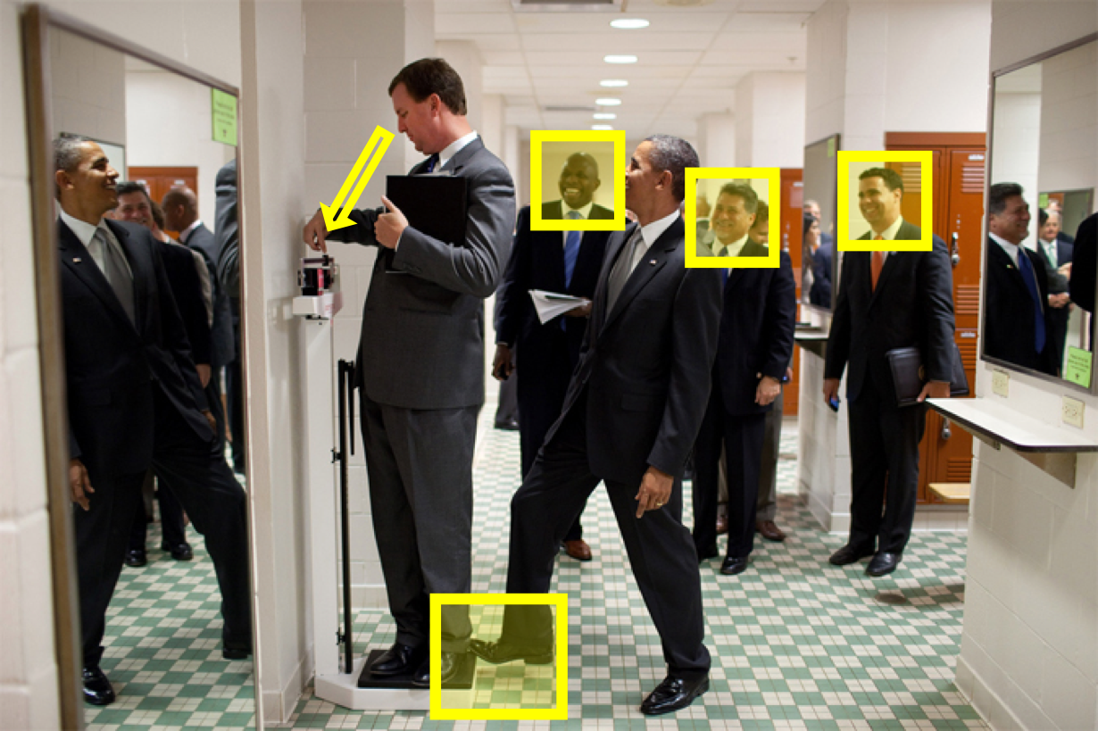
01 – Introduction to Computer Vision
Computer Vision is Challenging…
More realistic tasks:
Where was this picture taken?
How many people are there?
What are they doing?
What is the object the person on the left is standing on?
Why is this a funny picture?

Slide 16
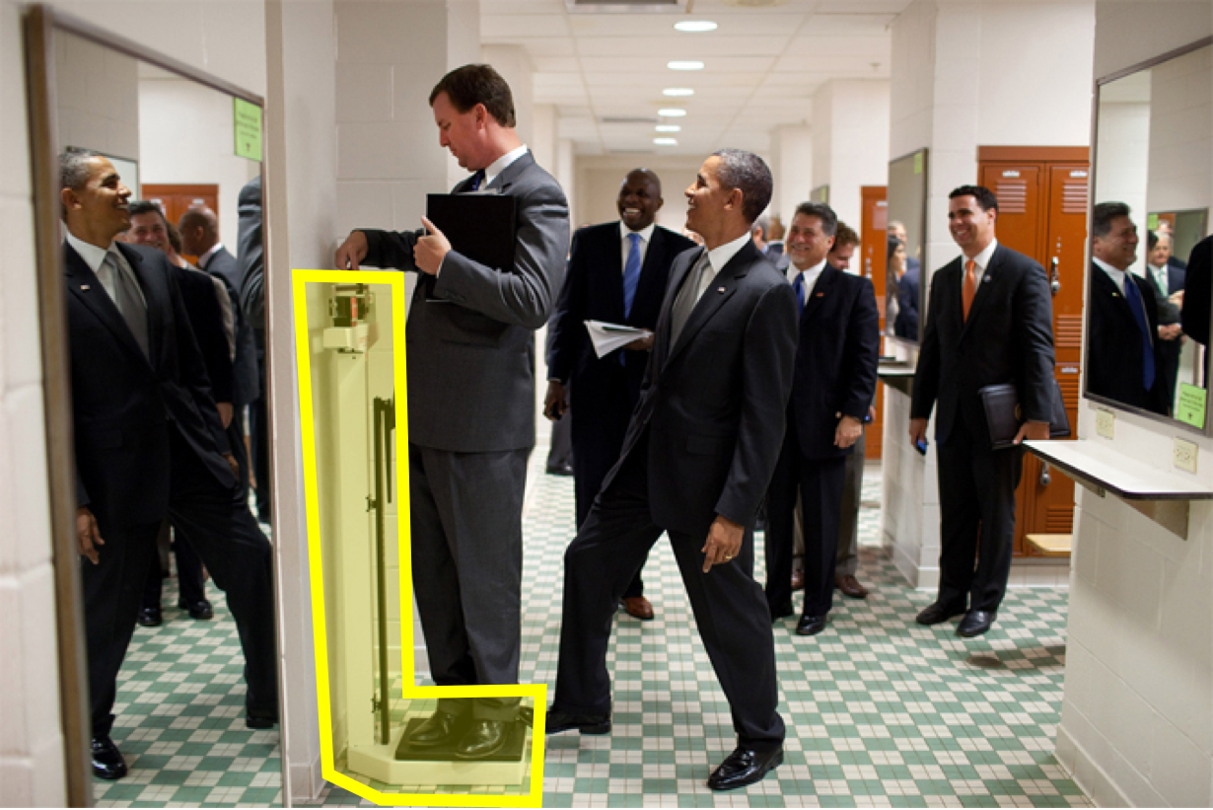
01 – Introduction to Computer Vision
Computer Vision is Challenging…
More realistic tasks:
Where was this picture taken?
How many people are there?
What are they doing?
What is the object the person on the left is standing on?
Why is this a funny picture?

Slide 17
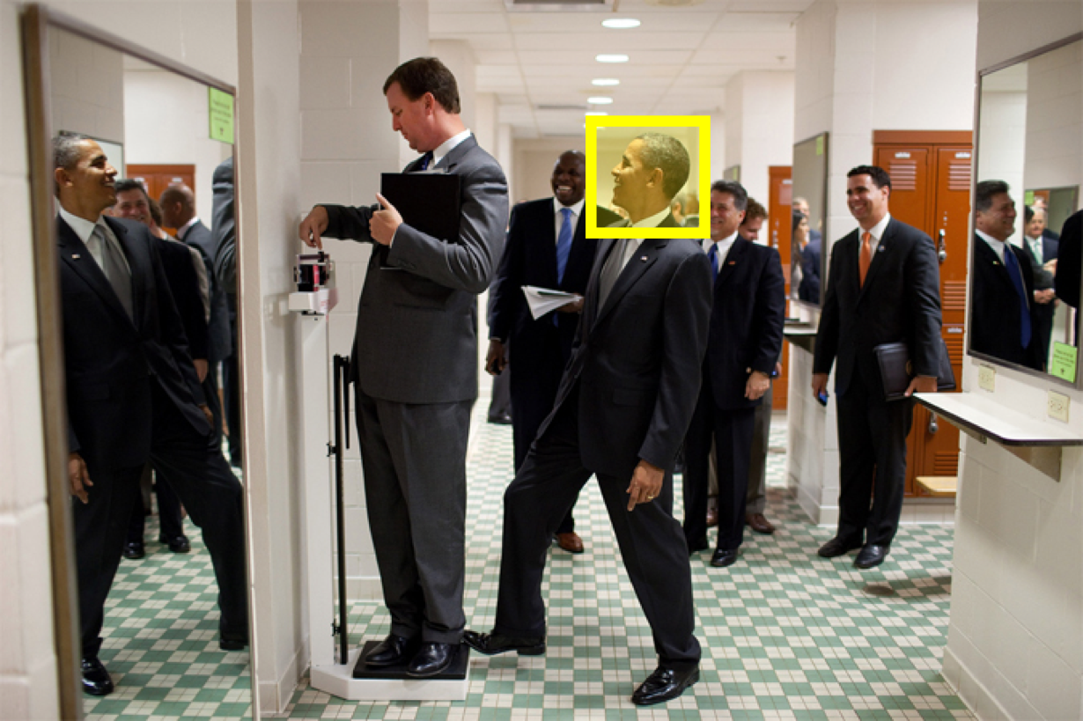
01 – Introduction to Computer Vision
Computer Vision is Challenging…
More realistic tasks:
Where was this picture taken?
How many people are there?
What are they doing?
What is the object the person on the left is standing on?
Why is this a funny picture?

Slide 18
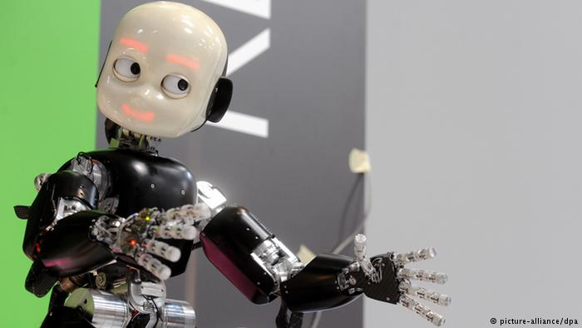
02 – 2D Robot Vision

Slide 19
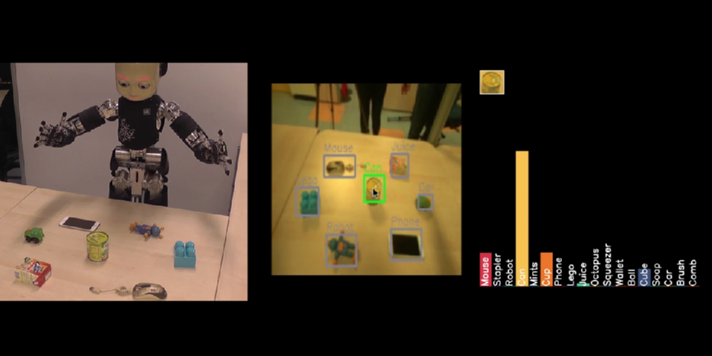
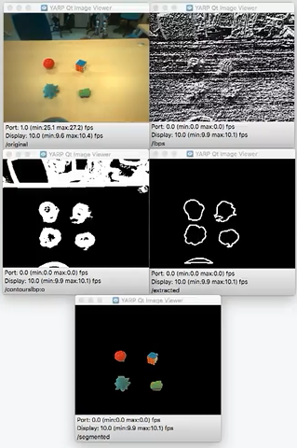
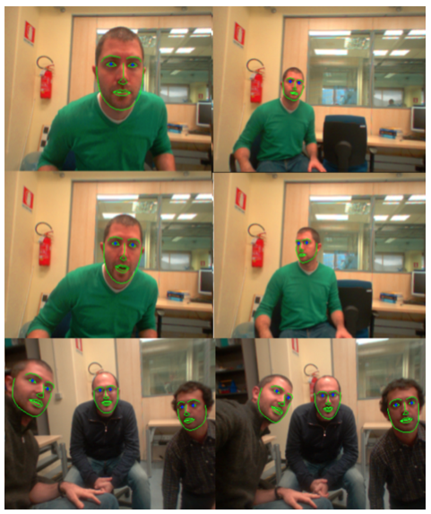
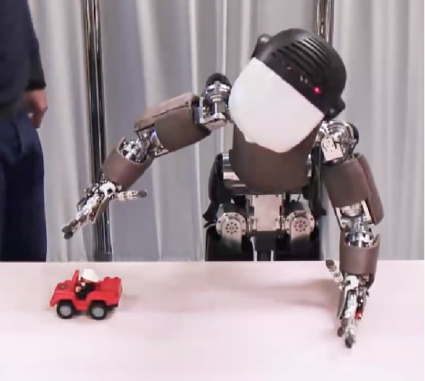
02 – 2D Robot Vision

Slide 20
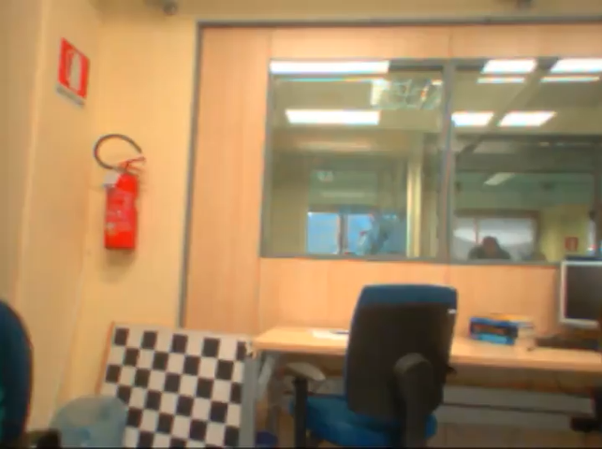
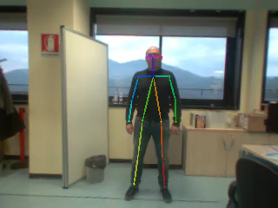
02 – 2D Robot Vision

Slide 21
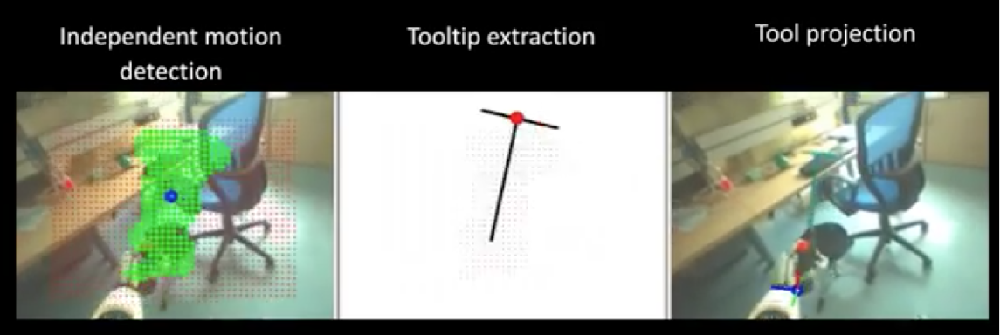
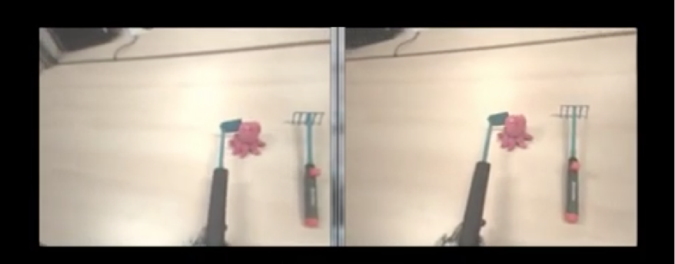
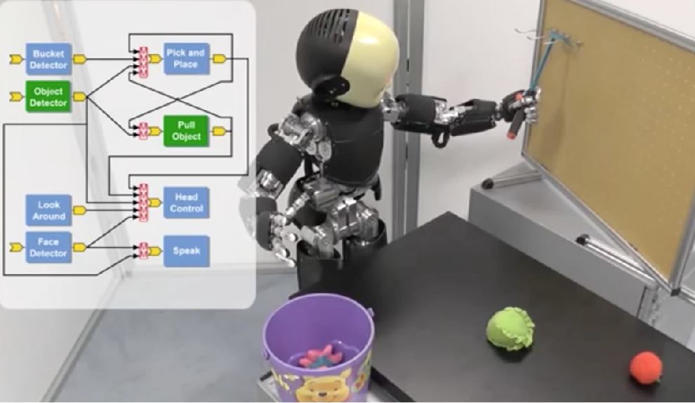
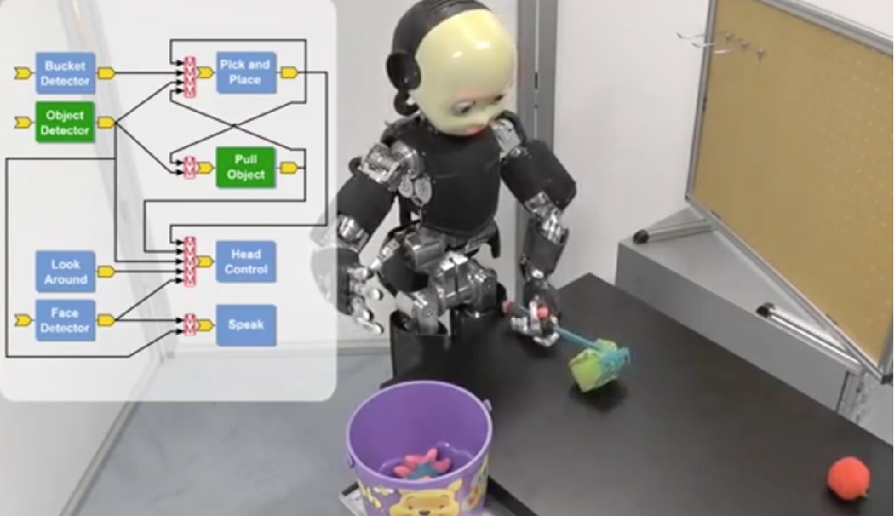
02 – 2D Robot Vision

Slide 22
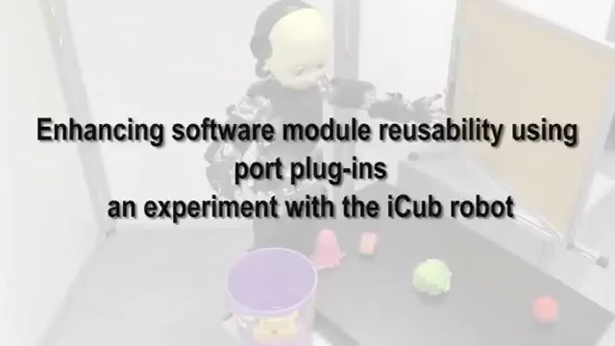
02 – 2D Robot Vision

Slide 23
02 – 2D Robot Vision
Image Processing
What is meant by image processing?
It is an umbrella term for many functions that:
Analyses images
Convert one representation into another
Perform operations on an image to:
get an enhanced image,
extract useful information from it.
Type of signal processing
Input is an image
Output is an image or characteristics/features
Examples
Filtering
Image Enhancement
Edge detection
Segmentation
Image Analysis
Applications that Process Images
Object segmentation
Face recognition
Iris recognition
Fingerprint recognition
Character recognition
Mathematical morphology
Detecting Edges

Slide 24
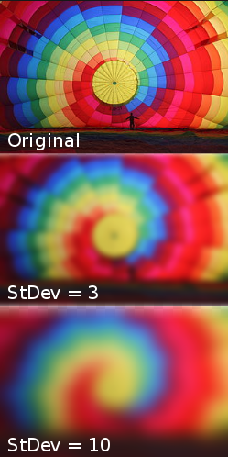
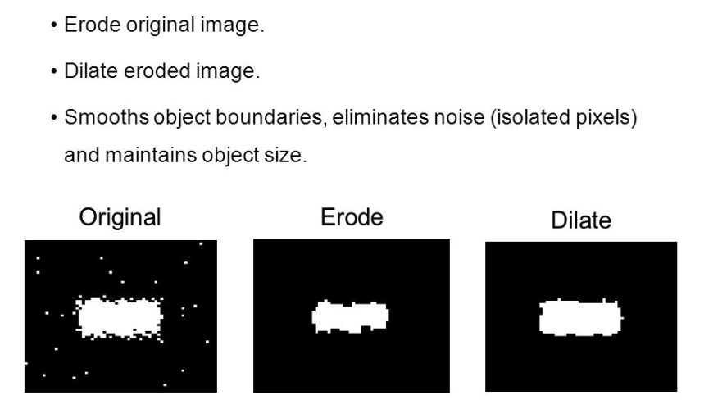
02 – 2D Robot Vision
Image Processing

Slide 25
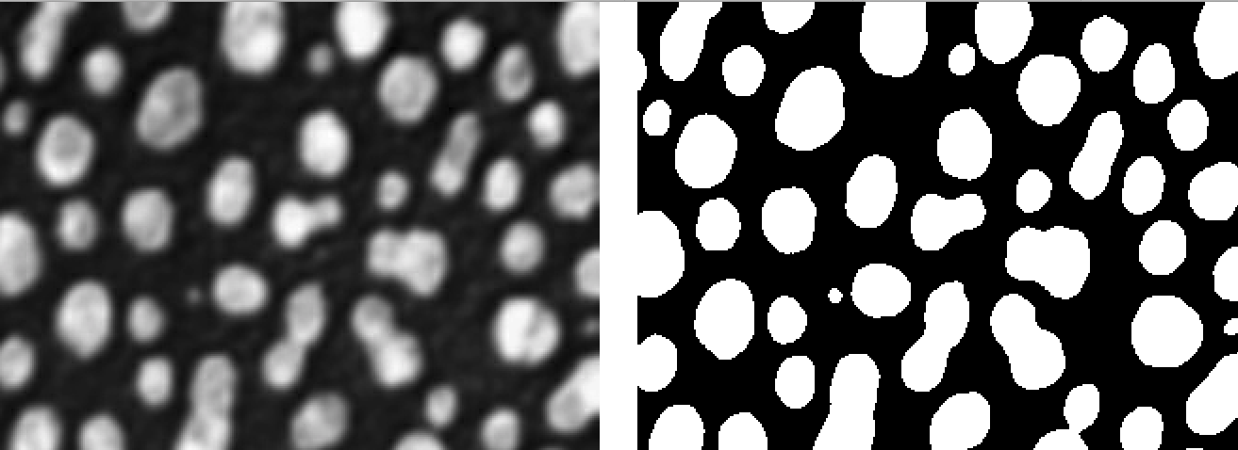
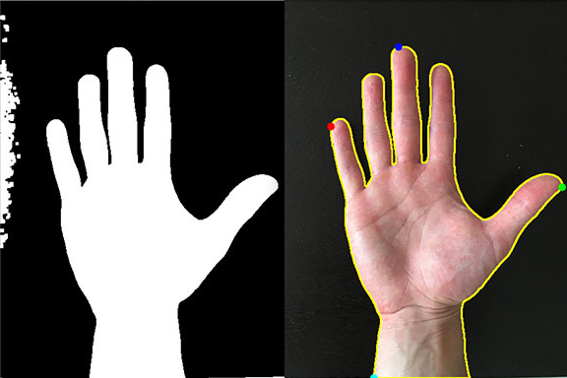
02 – 2D Robot Vision
Image Processing
Thresholding Image
Find Contours in image

Slide 26
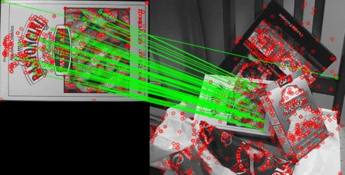
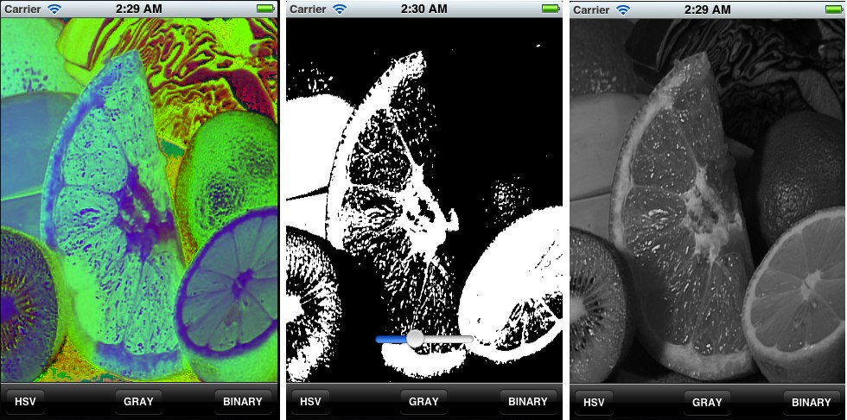
02 – 2D Robot Vision
OpenCV Library
OpenCV is a large scale, open library for computer vision (in C++, w/ Python, Java and Matlab interfaces).
The OpenCV framework contains numerous state-of-the art algorithms including filtering, feature extraction and matching, 3D reconstruction, video analysis and many more.
OpenCV is cross-platform, and has been successfully compiled and deployed on Linux, MacOS, Windows, and Android/iOS.
Website: opencv.org

Slide 27
02 – 2D Robot Vision
Tutorial Image Processing
Simple module that basically:
Track something round and red :-)
Work on live image streams
performing simple image processing
Spatial Filters (GaussianBlur)
Morphology (dilate, erode )
Detect Circles (HoughCircles)
https://github.com/vvv-school/tutorial_yarp-opencv

Slide 28
03 – 3D Robot Vision

Slide 29
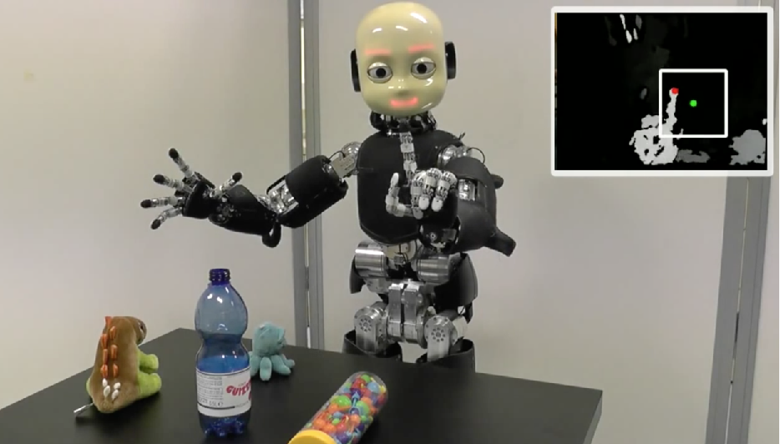
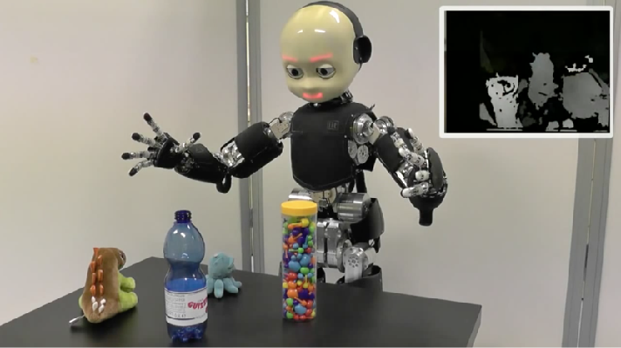
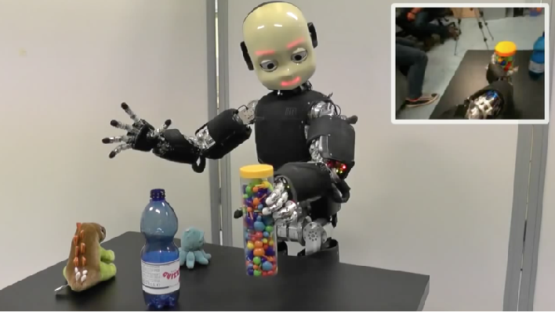
03 – 3D Robot Vision

Slide 30
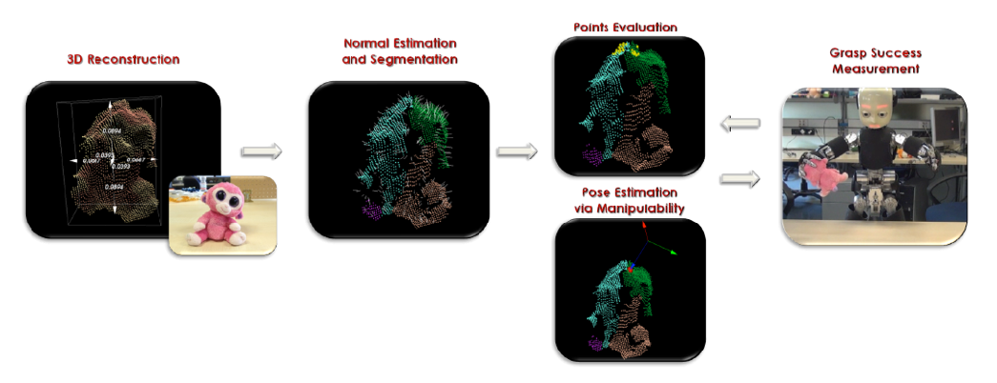
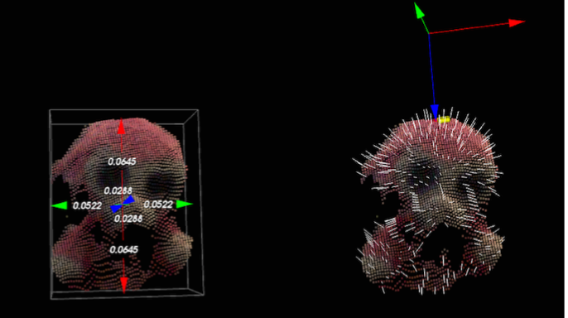
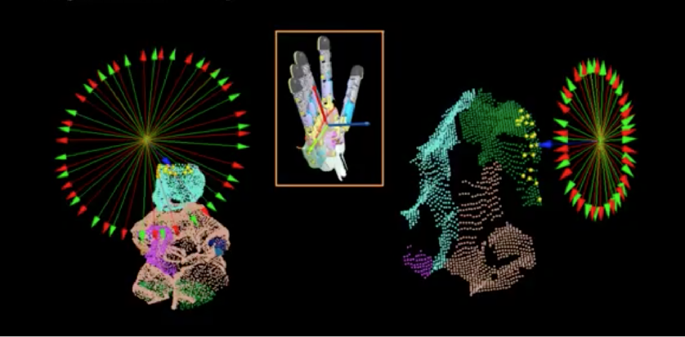
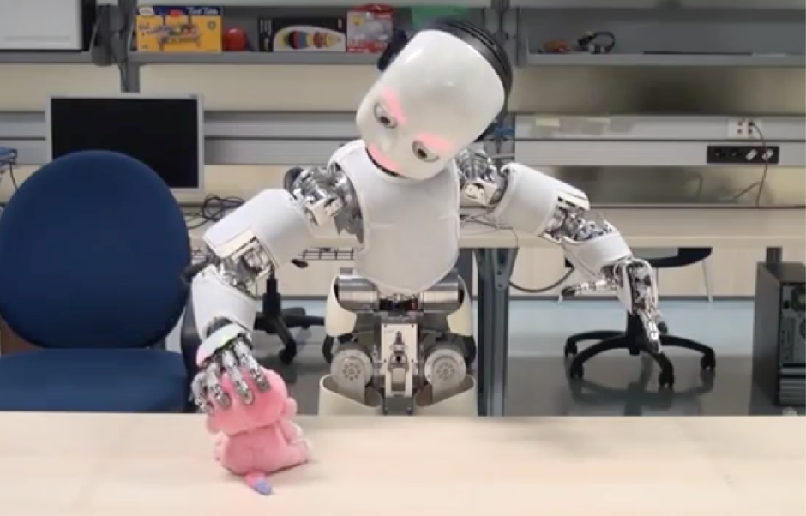
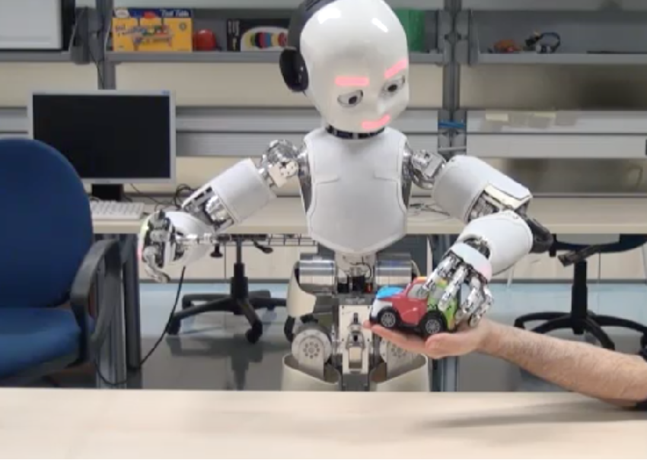
03 – 3D Robot Vision

Slide 31
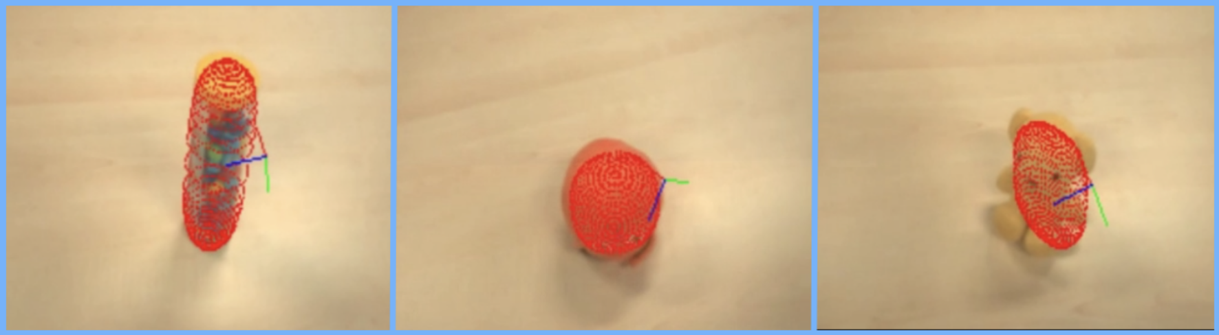

03 – 3D Robot Vision

Slide 32
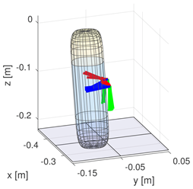

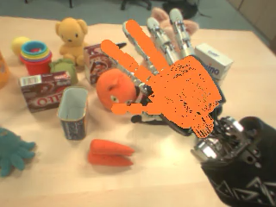
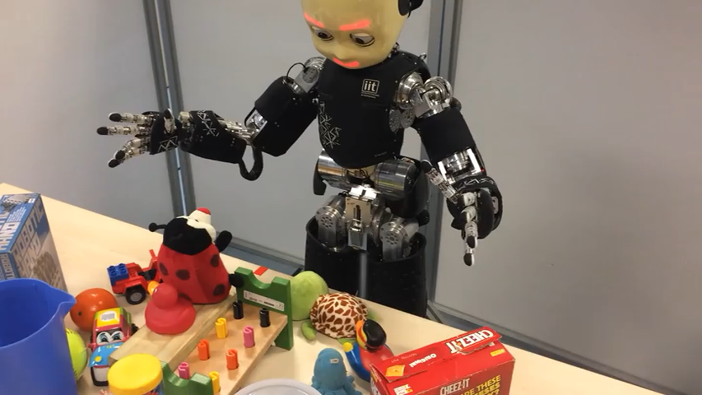
03 – 3D Robot Vision

Slide 33
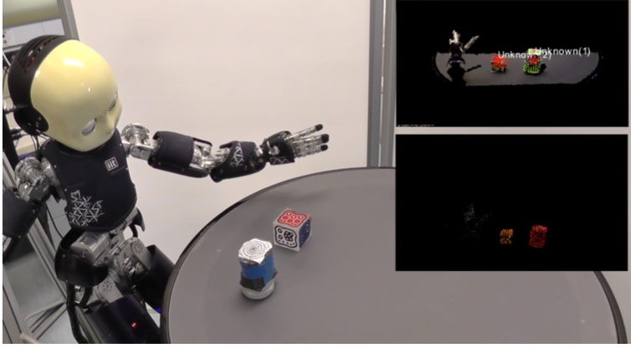
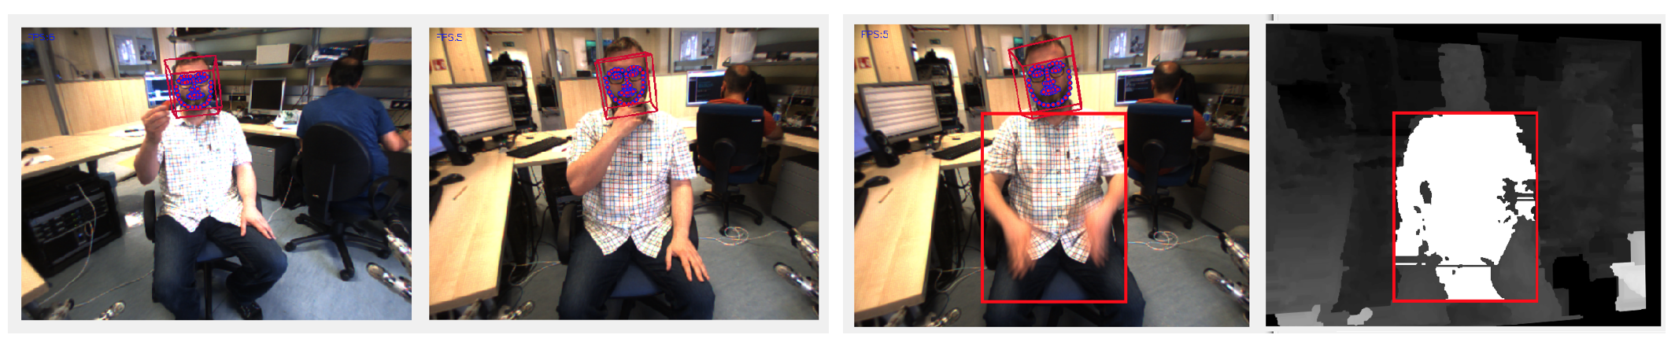
03 – 3D Robot Vision

Slide 34

03 – 3D Robot Vision

Slide 35
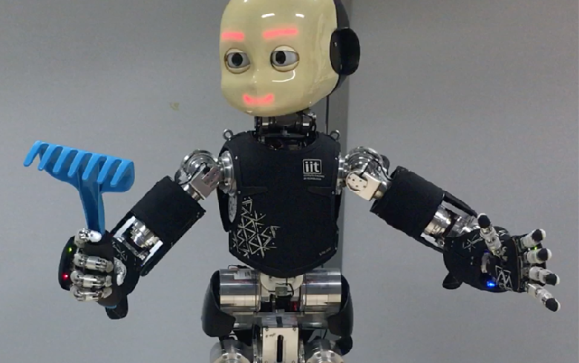



03 – 3D Robot Vision

Slide 36
03 – 3D Robot Vision

Slide 37


03 – 3D Robot Vision

Slide 38

03 – 3D Robot Vision

Slide 39

03 – 3D Robot Vision

Slide 40

03 – 3D Robot Vision

Slide 41
03 – 3D Robot Vision

Slide 42



03 – 3D Robot Vision
Point Clouds
A point cloud is a data structure that represents a collection of multi-dimensional points and is commonly used to represent three-dimensional data.
In a 3D point cloud, the points usually represent the X, Y, and Z geometric coordinates of an underlying sampled surface. When color information is present, the point cloud becomes 4D.

Slide 43


03 – 3D Robot Vision
Point Clouds
Where do point clouds come from?
RGBD Cameras
Stereo Cameras
3D Laser Scanners
Time of Flight Cameras
Synthetically from Software

Slide 44

03 – 3D Robot Vision
PCL Library
PCL is a large scale, open project for 2D/3D image and point cloud processing (in C++, w/ new python bindings).
The PCL framework contains numerous state-of-the art algorithms including filtering, feature estimation, surface reconstruction, registration, model fitting and segmentation.
PCL is cross-platform, and has been successfully compiled and deployed on Linux, MacOS, Windows, and Android/iOS.
Website: pointclouds.org

Slide 45
03 – 3D Robot Vision
PCL Library
Data type:
The basic data type in PCL is a PointCloud. A PointCloud is a templated C++ class which contains the following data fields:
width (int) - specifies the width of the point cloud dataset in the number of points.
the total number of points in the cloud (equal with the number of elements in points) for unorganized datasets
the width (total number of points in a row) of an organized point cloud dataset
height (int) - specifies the height of the point cloud dataset in the number of points.
set to 1 for unorganized point clouds
the height (total number of rows) of an organized point cloud dataset
points (std::vector⟨PointT⟩) - contains the data array where all the points of type PointT are stored.

Slide 46
03 – 3D Robot Vision
PCL Library
Types:
PointXYZ - float x, y, z
PointXYZI - float x, y, z, intensity
PointXYZRGB - float x, y, z, rgb
PointXYZRGBA - float x, y, z, uint32 t rgba
Normal - float normal[3], curvature
PointNormal - float x, y, z, normal[3], curvature
Histogram - float histogram[N]
And many, many, more. Plus you can define new types to suit your needs.

Slide 47

03 – 3D Robot Vision
PCL Library

Slide 48


03 – 3D Robot Vision
3D Segmentation
Technique to partition point clouds into multiple smaller point clouds.
RANdom SAmple Consensus
Clustering
Estimates parameters of a mathematical model that fits a set of data containing outliers:
Randomly select a subset of the dataset
Fit the model to the selected subset
Determine the number of outliers
Iterate!
Groups point clouds based on the similarity between pairs of points (e.g. Euclidean distance)

Slide 49

03 – 3D Robot Vision
Iterative Closest Point
Technique to align two point clouds with each other.
Point Cloud Alignment: estimate transformation to move one cloud so that it is aligned with the other one.
How does it work:
Data association step
Transformation step

Slide 50


03 – 3D Robot Vision
Iterative Closest Point
Data association step
Nearest neighbour approach

Slide 51



03 – 3D Robot Vision
Iterative Closest Point
2. Transformation step
Computes the center of mass
Computes the rotation using SVD

Slide 52


03 – 3D Robot Vision
Iterative Closest Point
Estimating the data association is the key challenge
Repeat process:
Recompute data associations
Recompute alignment
Over and over again... until we converge

Slide 53



03 – 3D Robot Vision
Iterative Closest Point
Real world example
Determine the best pose to grasp an object within a set of objects
Convergence criteria:
# iterations >= maximum
RMSE <= threshold
Δ consecutive transformations <= threshold

Slide 54



03 – 3D Robot Vision
Iterative Closest Point
Failure cases
Starting positions completely different
Partial point cloud or parts not visible
Different scale

Slide 55

03 – 3D Robot Vision
Iterative Closest Point
ICP iteratively revises the transformation (translation, rotation) needed to minimize the distance between the points of two raw scans.
Inputs: points from two raw scans, initial estimation
of the transformation, criteria for stopping the iteration.
Output: refined transformation.
The algorithm steps are :
Associate points by the nearest neighbour criteria.
Estimate transformation parameters using a mean square cost function
Transform the points using the estimated parameters.
Iterate (re-associate the points and so on).

Slide 56
02 – 2D Robot Vision
Tutorial Image Processing
Simple module that basically:
Track something round and red :-)
Work on live image streams
performing simple image processing
Spatial Filters (GaussianBlur)
Morphology (dilate, erode )
Detect Circles (HoughCircles)
https://github.com/vvv-school/tutorial_yarp-opencv

Slide 57
Robot
{vision}

